Slide 1
Move semantics && rvalue references, part 2
Bert Rodiers, Software Architect Siemens Industry Software NV

Slide 2
Move semantics && rvalue references
Part 2
Alternative implementations for move operations
Rvalue references and templates (different binding rules)
Forwarding references ⬄ Reference Collapsing rules
Perfect forwarding
std::forward
How to pass arguments
(Moving into C++14 lambda expressions)
(Emplace)

Slide 3
Implementing Move Semantics
CMyIntVector& operator=(CMyIntVector&& vector) noexcept {
assert(&vector != this); // Alternative: If-test
// Clean-up memory
delete[] data_;
// Fill-in members
size_ = vector.size_;
data_ = vector.data_;
// Make vector an “empty”-vector
vector.size_ = 0;
vector.data_ = nullptr;
return *this;
}

Slide 4
Alternative implementations for move operations
std::swap to exchange members
Call move assignment operator in move constructor
Pass by value in assignment operator
Copy/swap idiom

Slide 5
Alternatives - std::swap to exchange members
CMyIntVector& operator=(CMyIntVector&& vector) noexcept {
using std::swap;
swap(data_, vector.data_);
swap(size_, vector.size_);
return *this;
}
Advantages:
Cleaner and easier code
Issues:
More expensive
Delays destruction (less deterministic)
Side effects (such as unlock)
Originally introduced by Howard Hinnant
doesn’t use the pattern anymore

Slide 6
Alternatives - Call move assignment operator in move constructor
Source: MSDN
Howard Hinnant: “Move operations are created for performance”
CMyIntVector(CMyIntVector&& other) noexcept : data_(nullptr) , size_(0)
{
*this = std::move(other);
}
 | Original | This implementation
push_back of CMyIntVector | 846 ms | 939 ms
push_back of CIntPair | 105 ms | 136 ms
Notes:
Numbers without reserve. No difference for CIntPair with reserve

Slide 7
Alternatives - pass by value in assignment operator
operator= will move in implementation
Advantage:
Define one less
Strong exception safety guarantee (if move doesn’t throw)
Issues:
What with noexcept?
Performance (see later)
MyString(const MyString&);
MyString(MyString&&) noexcept;
MyString& operator=(MyString);

Slide 8
Alternatives - Copy/swap idiom
Combination of 2 alternatives:
Swap functions call often grouped in separate swap function
Advantage:
Define one less
Strong exception safety guarantee
Implementation relatively trivial
Issues:
What with noexcept?
Performance (lvalues + rvalues)
Delays destruction
MyString& operator=(MyString string) {
std::swap(string_, string.string_); // swap every member variable
return *this;
}

Slide 9
Copy/swap idiom
Normal assignment operator
Copy/swap idiom
std::string longstring("Answer to The Ultimate Question of Life, the Universe, and Everything");
std::string shortstring("42");
longstring = shortstring; // no reallocation necessary
shortstring = longstring; // reallocation necessary
std::string longstring("Answer to The Ultimate Question of Life, the Universe, and Everything");
std::string shortstring("42");
longstring = shortstring; // reallocation necessary
shortstring = longstring; // reallocation necessary

Slide 10
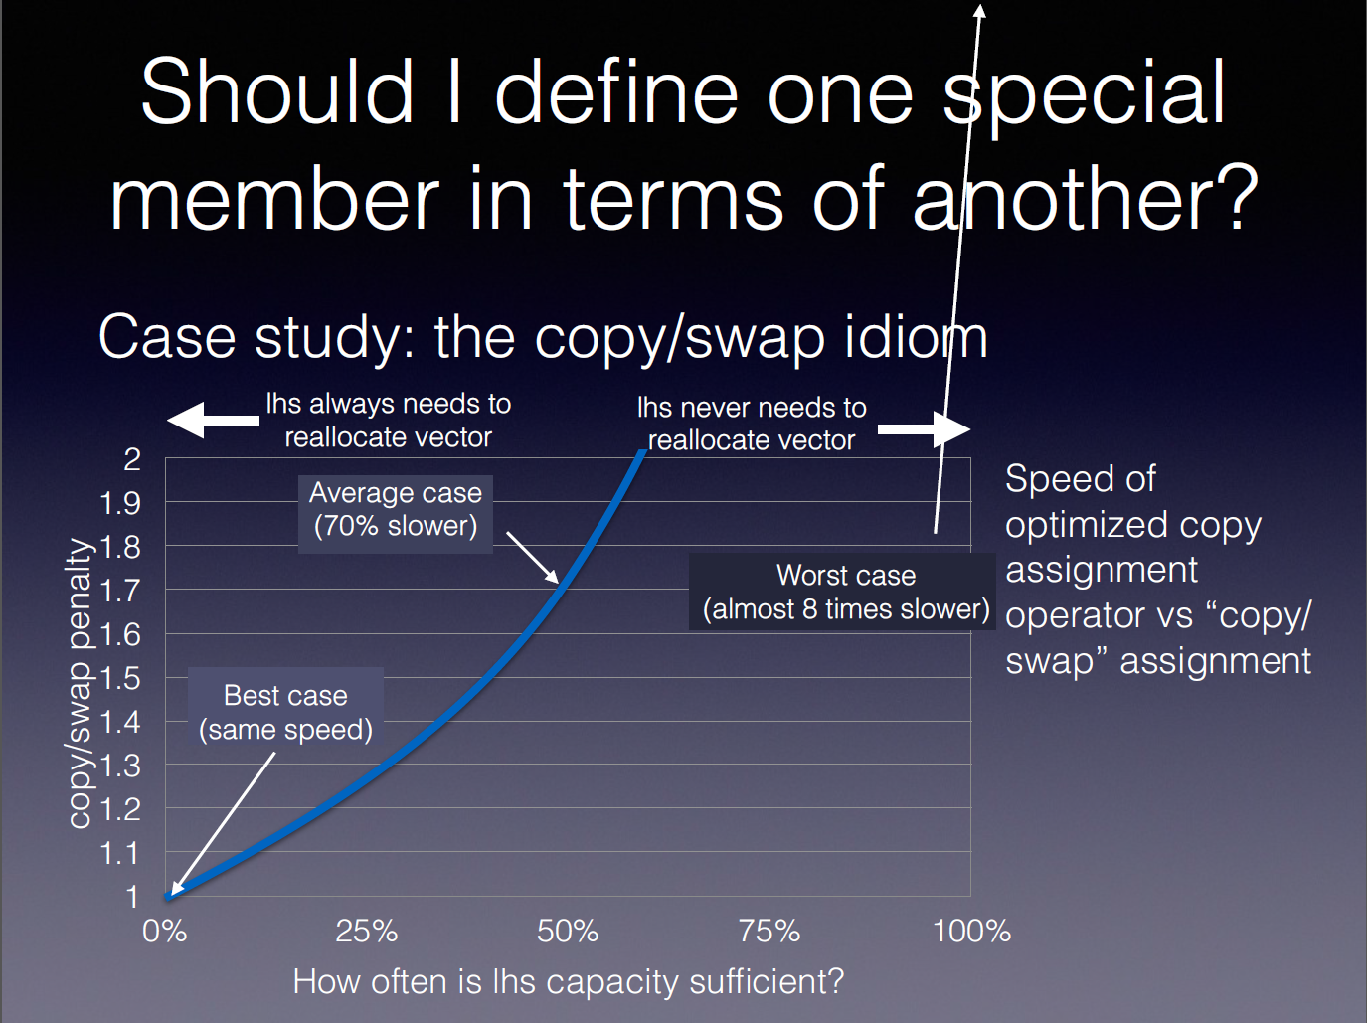
Slide by Howard Hinnant (ACCU 2014)

Slide 11
Move semantics – Optimal implementation
Rule of three five zero!
class MyString
{
public:
MyString(const char* string)
: string_(string) {}
private:
std::string string_;
};

Slide 12
Rvalue references and deduced types
Rules different with deduced types
Example
template <typename T> void f(T&& arg);
void g(int&& arg);
f(4);
g(4);

Slide 13
Rvalue references and deduced types
Rules different with deduced types
Example
template <typename T> void f(T&& arg);
void g(int&& arg);
int val = 4;
f(val);
g(val);
//error C2664: 'void g(int &&)' : cannot convert argument 1 from
// 'int' to 'int &&'

Slide 14
Rvalue references and deduced types
Rules different with deduced types
Example
template <typename T> void f(T&& arg);
void g(int&& arg);
int val = 4;
f(val);
g(std::move(val));

Slide 15
Rvalue references and deduced types
Rules different with deduced types
Example
template <typename T> void f(T&& arg);
void g(int&& arg);
const int val = 4;
f(val);
g(val);
//error C2664: 'void g(int &&)' : cannot convert argument 1 from
// ‘const int' to 'int &&'

Slide 16
Rvalue references and deduced types
Rules different with deduced types
Example
template <typename T> void f(T&& arg);
void g(int&& arg);
const int val = 4;
f(val);
g(std::move(val));
//error C2664: 'void g(int &&)' : cannot convert argument 1 from
// ‘const int' to 'int &&'

Slide 17
Rvalue references and deduced types
Rules different with deduced types
Templates, auto
T&& binds with everything (lvalues + rvalues)
Two views for T&&
Still Rvalue references
With reference-collapsing rules
T&& something completely different
Forwarding reference (universal reference)

Slide 18
Forwarding reference (universal reference)
T&& binds with everything (lvalues + rvalues)
Restriction
T has to have a specific form
std::vector<T>&&
const T&&
=> not a forwarding reference
=> forwarding reference?
template <typename T>
struct C
{
void f(T&& arg);
};

Slide 19
Forwarding reference: type deduction rules
template <typename T> void f(T&& arg);
const int const_val = 4;
f(const_val); // argument of function: const int&
int value = 42;
f(value); // argument of function: int&
f(g()); // argument of function: int&&
f(std::move(const_val)); // argument of function: const int&&
Lvalue => lvalue reference (T already has this type)
Different rules from normal template functions
Rvalue => rvalue reference
Const not removed

Slide 20
Forwarding reference: why?
make_unique without forwarding references
template<typename T, typename Type1 , typename Type2>
unique_ptr<T> make_unique(const Type1& arg1, const Type2& arg2)
{
return (unique_ptr<T>(new T(arg1, arg2)));
}
template<typename T, typename Type1 , typename Type2>
unique_ptr<T> make_unique(Type1&& arg1, Type2&& arg2)
{
return (unique_ptr<T>(new T(std::move(arg1), std::move(arg2)));
}
template<typename T, typename Type1 , typename Type2>
unique_ptr<T> make_unique(const Type1& arg1, Type2&& arg2)
{
return (unique_ptr<T>(new T(arg1, std::move(arg2)));
}
…

Slide 21
Forwarding reference: why?
Perfect forwarding
Example
template<typename T, typename Type1, typename Type2>
unique_ptr<T> make_unique(Type1&& arg1, Type2&& arg2)
{
return (unique_ptr<T>(new T(std::forward<Type1>(arg1),
std::forward<Type2>(arg2))));
}
template<typename T, typename... Types>
unique_ptr<T> make_unique(Types&&... args)
{
return (unique_ptr<T>(new T(std::forward<Types>(args)...)));
}

Slide 22
std::forward
T not deduced from argument
Forward converts type back to rvalue (reference)
Remember: if has name => lvalue
When to use std::forward?
Forwarding reference
Forward: only cast to rvalue reference if originally rvalue
std::forward<Type1>(arg1)
Rvalue reference (not forwarding reference)
Move: unconditionally cast
std::move(arg1)

Slide 23
Perfect forwarding not so perfect
Most common failure: braced initializer lists
void f(const std::vector<int>&);
template<typename T>
void g(T&& arg)
{
f(std::forward<T>(arg));
}
f({ 1, 2 }); // Compiles
g({ 1, 2 }); // Doesn't compile
auto values = { 1, 2 };
g(values); // Compiles

Slide 24
Reference-collapsing rules
Second Vision: T&&: Still Rvalue references
Needs
Different rules for type deduction
reference-collapsing rules
Two types involved:
Declared template argument (for example T&&)
Type of passed argument (for example (int&))
Different rules for type deduction (lvalue ⬄ rvalue)
template <typename T> void f(T&& arg);
int value = 42;
f(value); // T deduced to int&
f(42); // T deduced to int

Slide 25
Reference-collapsing rules
template <typename T> void f(T&& arg);
int value = 42;
f(value); // T deduced to int&
f(42); // T deduced to int
f(value);
T = int&
arg: T&& == int& && => int&
f(42);
T = int
arg: T&& == int&& => int&&

Slide 26
Reference-collapsing rules
Lvalue + lvalue reference => lvalue reference
Lvalue + rvalue reference => lvalue reference
Rvalue + rvalue reference => rvalue reference
Occurs:
Template instantiation
Auto variables
Typedef + alias declaration
Decltype
template<class T>
T&& forward(typename remove_reference<T>::type& arg) noexcept
{
return (static_cast<T&&>(arg));
}

Slide 27
How to pass arguments
Different alternatives
void setName(const std::string& name) { name_ = name; }
Lvalue: 1 copy¹
Rvalue: 1 copy¹
void setName(const std::string& name) { name_ = name; }
void setName(std::string&& name) noexcept { name_ = std::move(name); }
Lvalue: 1 copy¹
Rvalue: 1 move
void setName(std::string name) { name_ = std::move(name); }
Lvalue: 1 copy² + 1 move (Note: SSO)
Rvalue: 2 moves

Slide 28
How to pass arguments
4. template<typename T> void setName(T&& name) { name_ = std::forward<T>(name); }
Lvalue: 1 copy¹
Rvalue: 1 move
5. template<typename T> typename std::enable_if<std::is_convertible<T, std::string>::value, void>::type setName(T&& name) { name_ = std::forward<T>(name); }
Lvalue: 1 copy¹
Rvalue: 1 move

Slide 29
How to pass arguments
Solution 1 (const&)
Performance not optimal for rvalues
Solution 2 (const& + &&)
Performance optimal
More code to maintain
Solution 3 (value)
(Possibly huge) Pessimization for lvalues, small pessimization for rvalues
What with noexcept?
Solution 4 (T&& + forward)
Error message not @function call, but deep in implementation code
Accepts a.setName(42) (Explicit constructors)
What with noexcept?
Solution 5 (T&& + enable_if + forward)
Complex
Error messages not obvious (“Failed to specialize function template”)
What with noexcept?

Slide 30
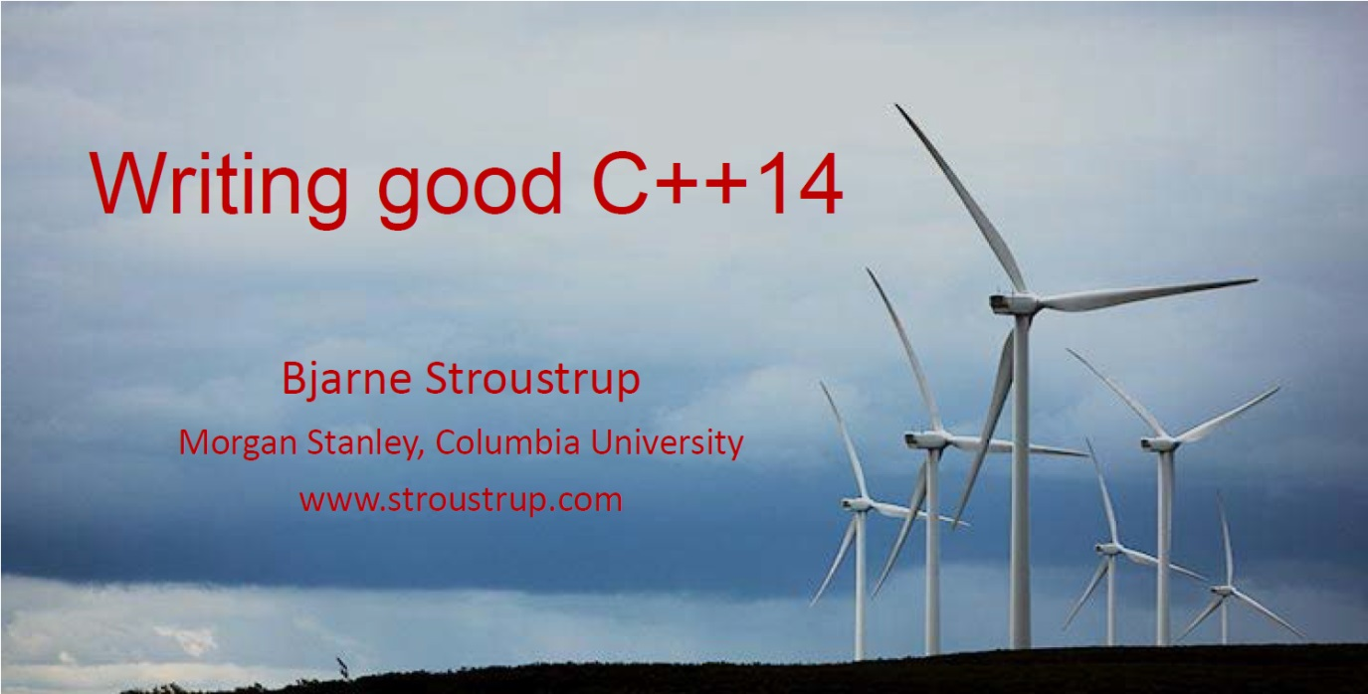
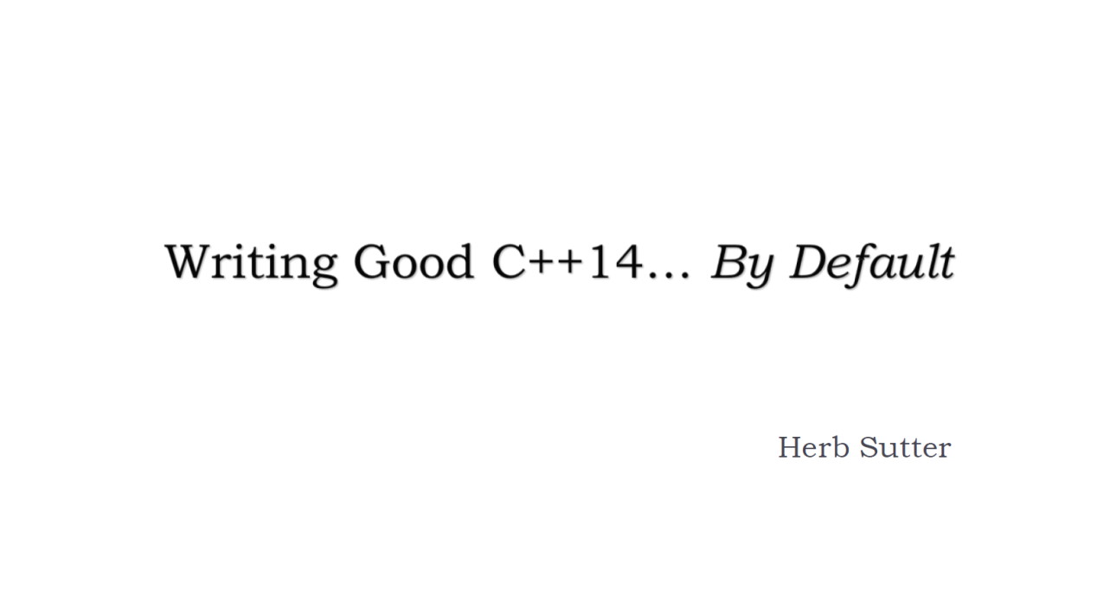
CppCon2015

Slide 31
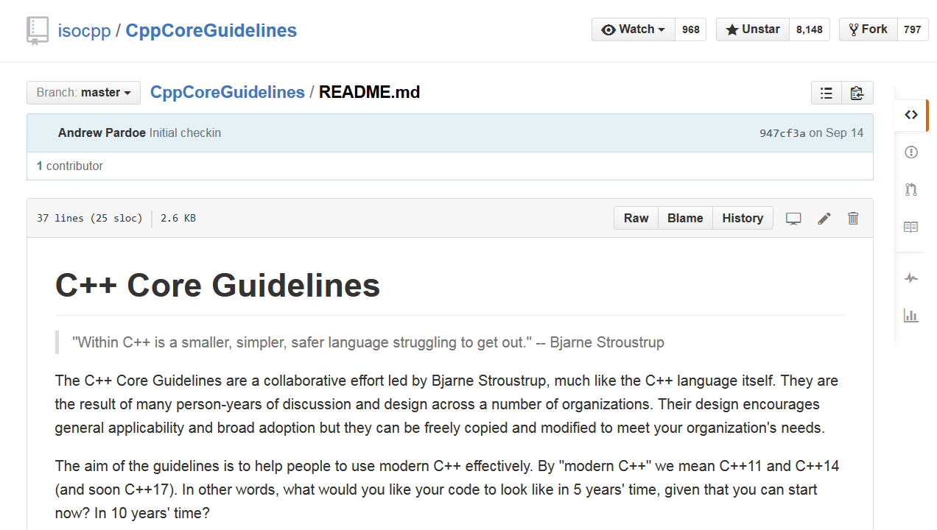
C++ Core Guidelines

Slide 32
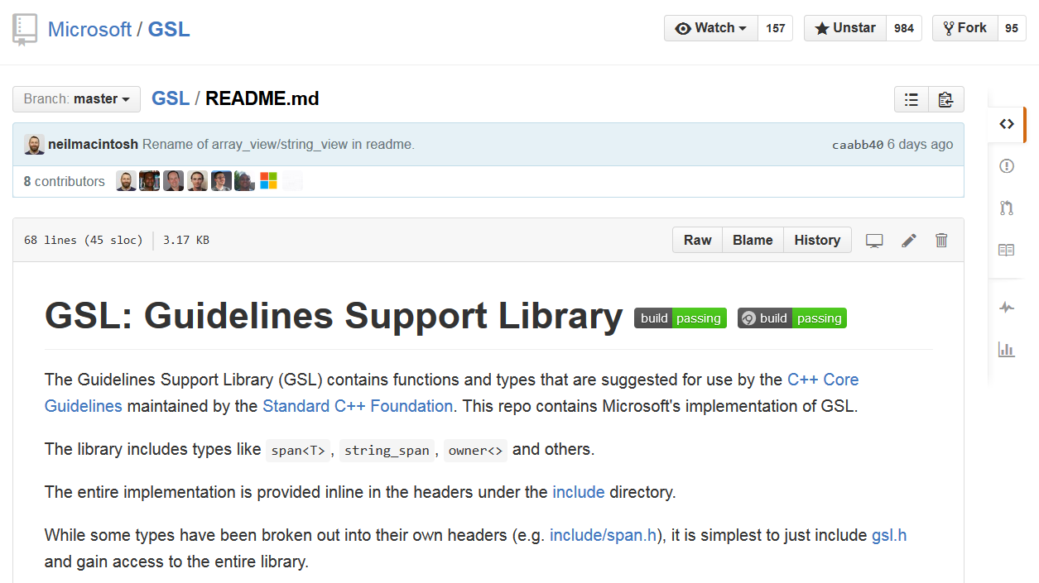
GSL: Guidelines Support Library

Slide 33
How to pass arguments
 | Cheap to copy (e.g. int) | Cheap to move (vector<T>, string) or Moderate cost to move or Don’t know | Expensive to move
Out | X f() |  | f(X&)
In/Out | f(X&)
In | f(X) | f(const X&)
In & retain “copy”

Slide 34
How to pass arguments - advanced
 | Cheap to copy (e.g. int) | Cheap to move (vector<T>, string) or Moderate cost to move or Don’t know | Expensive to move
Out | X f() |  | f(X&)
In/Out | f(X&)
In | f(X) | f(const X&)
In & retain “copy” | f(X) | f(const X&) + f(X&&) & move | f(const X&)
In & move from | f(X&&)

Slide 35
Summary
Alternative implementations for move operations
Rule of zero
Rvalue references and templates (different binding rules)
Forwarding references ⬄ Reference Collapsing rules
Perfect forwarding
std::forward
How to pass arguments
(Moving into C++14 lambda expressions)
(Emplace)

Slide 36
Questions?

Slide 37
Side-topic: moving into lambdas
Doesn’t compile!
template <typename T> std::unique_ptr<T> generate(T arg);
class A
{
public:
void consume(std::unique_ptr<int>, int);
};
std::function<void(int)> f(std::shared_ptr<A>& a)
{
std::unique_ptr<int> value = generate(42);
return [value, a](int arg) mutable {
return a->consume(std::move(value), arg); };
}

Slide 38
Side-topic: moving into lambdas – second try
Compiles…
… but undefined behavior
std::function<void(int)> f(std::shared_ptr<A>& a)
{
std::unique_ptr<int> value = generate(42);
return[&value, a](int arg) mutable {
return a->consume(std::move(value), arg); };
}

Slide 39
Side-topic: moving into lambdas – third try
Generalized lambda captures
By reference: [&a = a] or [&a = b]
By value: [c = d] or [c = c]
// std::function<void(int)> f(std::shared_ptr<A>& a)
auto f(std::shared_ptr<A>& a)
{
std::unique_ptr<int> value = generate(42);
return[value = std::move(value), a](int arg) mutable {
return a->consume(std::move(value), arg); };
}

Slide 40
Side-topic: emplace_back
Remember MyString with move operations (push_back in for loop: 932 ms*)
* Different machine
for (int i = 0; i < count; ++i)
{
vector.push_back(MyString("To be, or not to be,
that is the question: Whether…"));
}
for (int i = 0; i < count; ++i)
{
vector.emplace_back("To be, or not to be,
that is the question: Whether…");
}

Slide 41
Side-topic: emplace_back
Remember MyString with move operations (push_back in for loop: 932 ms*)
MyString using emplace_back: 901 ms*
MyString constructed in-place
No copy/move
Can take more arguments
For loop with std::vector<std::tuple<std::string, int, double>>
std::vector<std::tuple<std::string, int, double>> vector;
vector.push_back(std::make_tuple("test", 42, 0.));
vector.emplace_back("test", 42, 0.);
 | push_back | emplace_back
Without reserve | 682 ms | 579 ms
With reserve | 277 ms | 146 ms

